Slide 1
Leveraging My Business Builder to Manage & Grow Your Enterprise
Spring 2026

Slide 2
Table of Contents
My Business Builder Overview
  What is available to you and your Advisors today
  What we are working on and testing
Accessing and Using My Business Builder with Enhanced Access (if you would like)
  How YOU Access the System to look across your Advisors
  How YOUR Advisors Access the System
  Strategic Enterprise Action Board

Slide 3
What is My Business Builder for Enterprises?
My Business Builder personalizes the delivery of Osaic’s business building resources to the Advisors in your Enterprise by narrowing the focus to their needs, based on where they are in the evolution of their business at any given time.
We can help you tailor the delivery for the unique needs of your Enterprise by creating a campaign specific to your business objectives.
Relationship Leader
Advisor Marketing
Technology Solutions
Wealth Solutions
Coaching & Consulting
Succession & Continuity
Your Advisors

Slide 4
Here is what we have built to date!
Items in Italics are examples in this overview deck
Business Coaching & Consulting
Next Level Coaching Program (1-Many)
Succession & Continuity
Business Valuation Estimate
Valuation for Independent Channel
Valuation Insights
S&A Transitions Dashboard
Prepared Buyer
Acquisition Financing
Continuity Coverage
Continuity In-take from
Advisor Marketing
Marketing Assessment
Technology Solutions
Associate Financial Professional
Subscription Coaching
New Affiliate Marketing Program (NAMP)
CRM Evaluation Assessment
Advisor Technology Assessment
Succession & Continuity Strategies
Elite Diagnostic (1-1)
Wealth Management Academy
Human Capital Consulting
Wealth Management
High Net Worth Intake Request Form
High Net Worth Advisor Development (being created)
Relationship Leader / Enterprise Toolkit
Business Diagnostic for Financial Professionals
Business Planning Wizard
Business Diagnostic for Large Enterprises
Digital Meeting Agendas
FP Jumpstart Assessment
Advisor Technology Dashboard

Slide 5
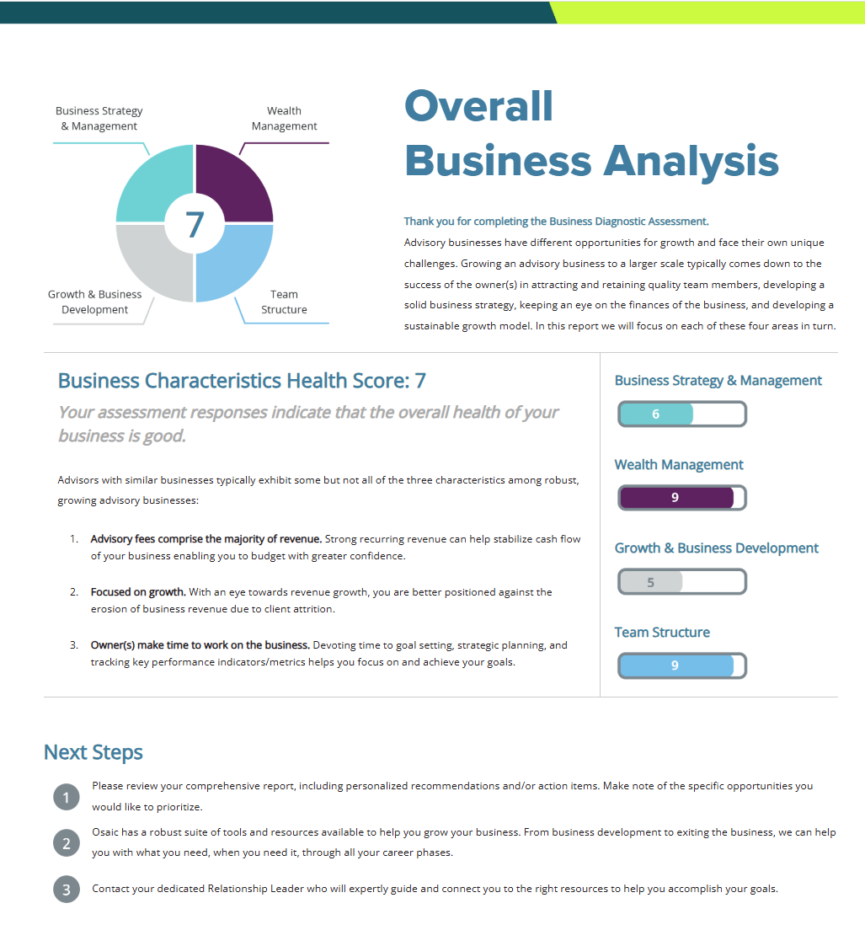
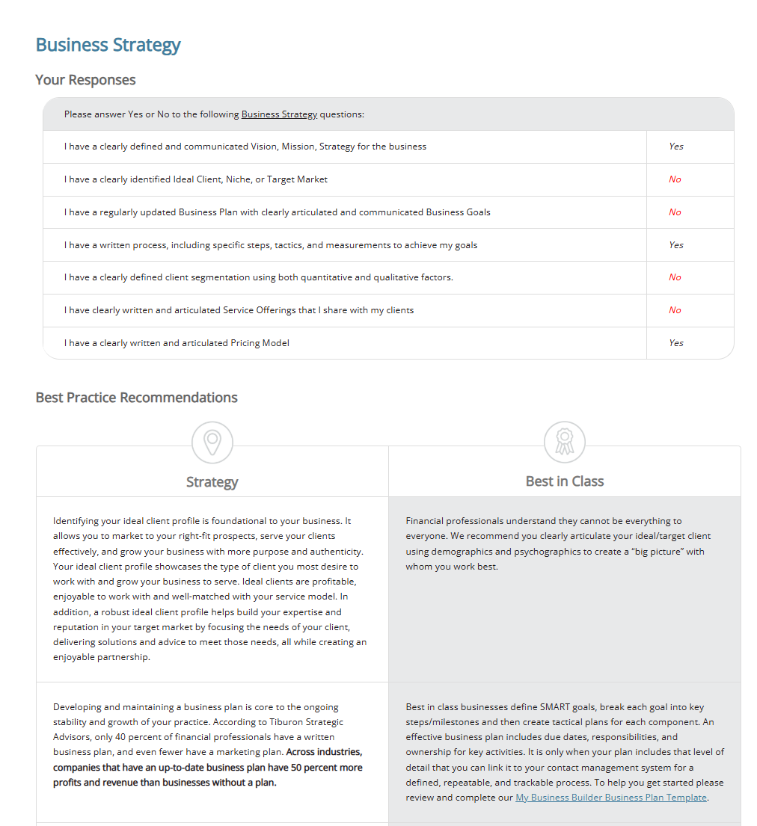
Business Diagnostic and Business Partnership
The 20 Minute Comprehensive Business Diagnostic highlights opportunities for improvement and has embedded links to self-service Osaic Solutions and overviews of paid-for programs

Slide 6
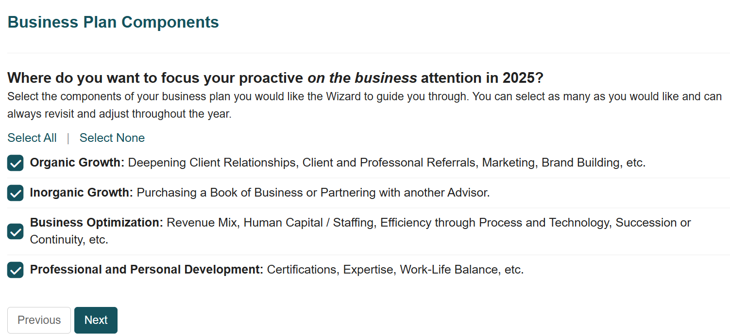
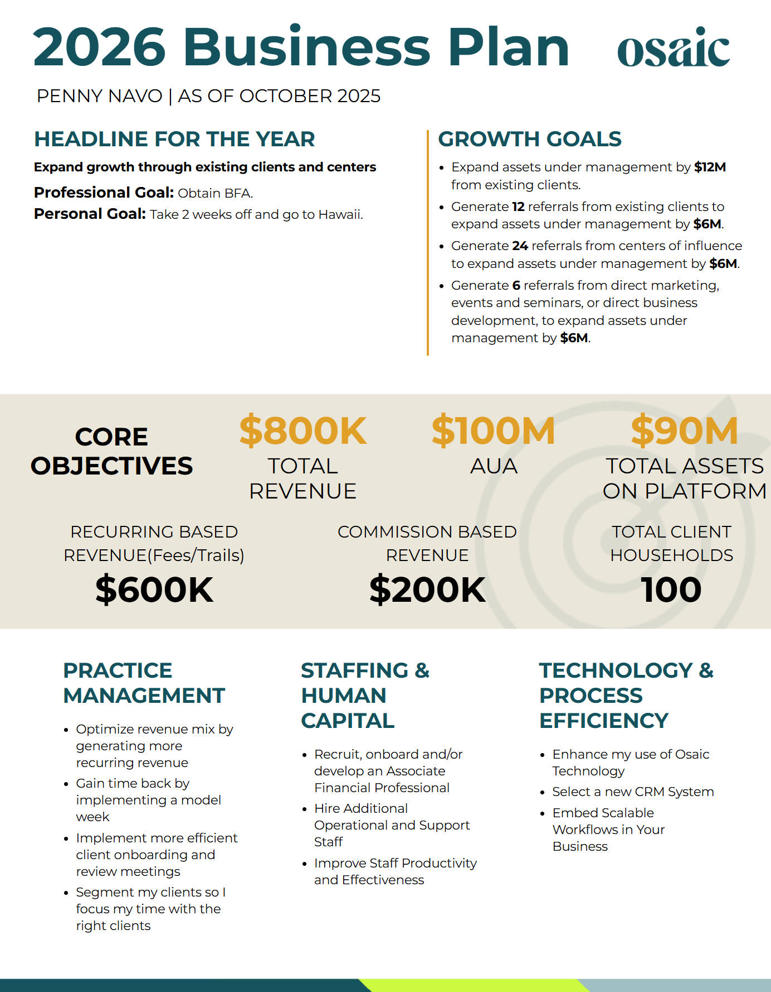
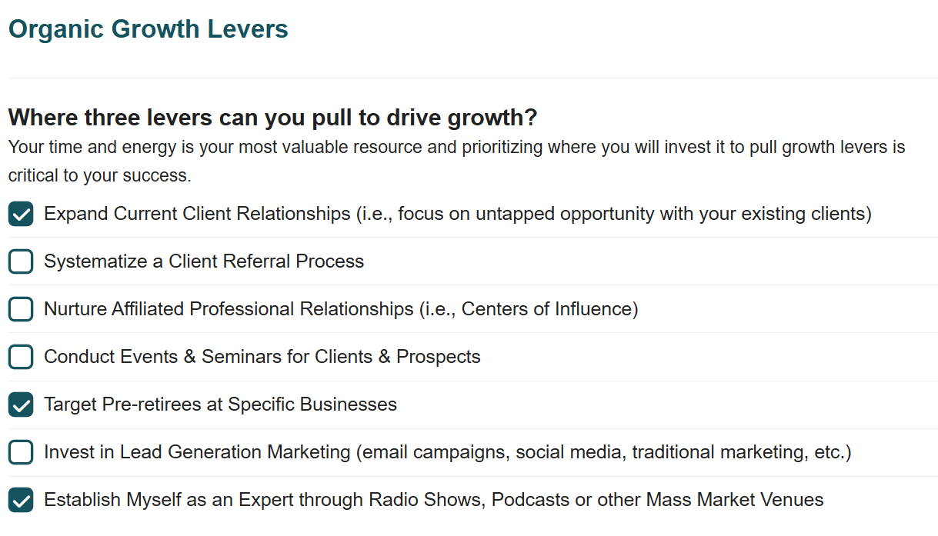
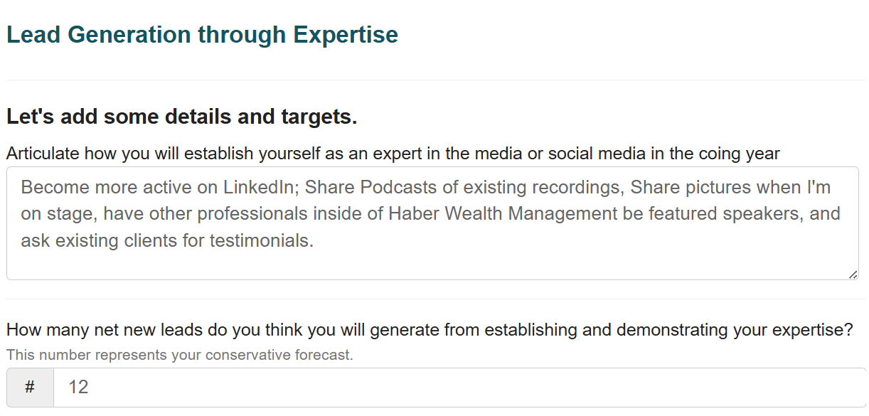
Business Planning Wizard (Ready to Pilot)
Creation of a plan in less than 20 minutes – option to include voice-to-text statements that are translated into AI-recommended next best actions
Subset of growth wizard questions
Personalized Report

Slide 7
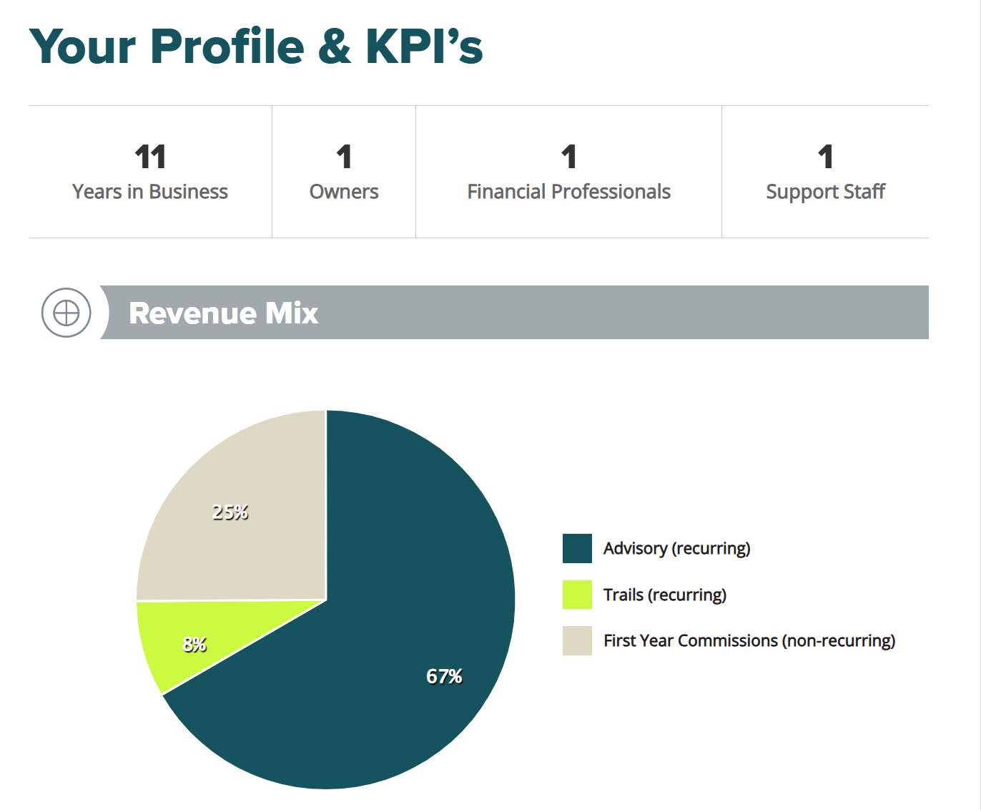
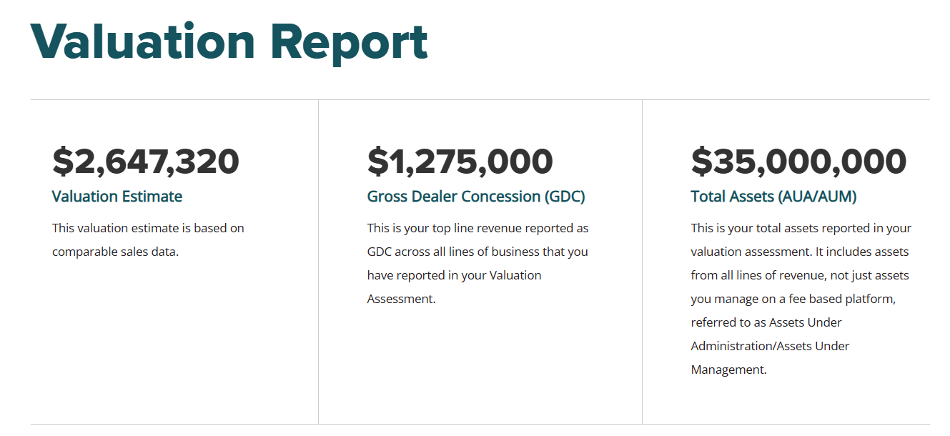
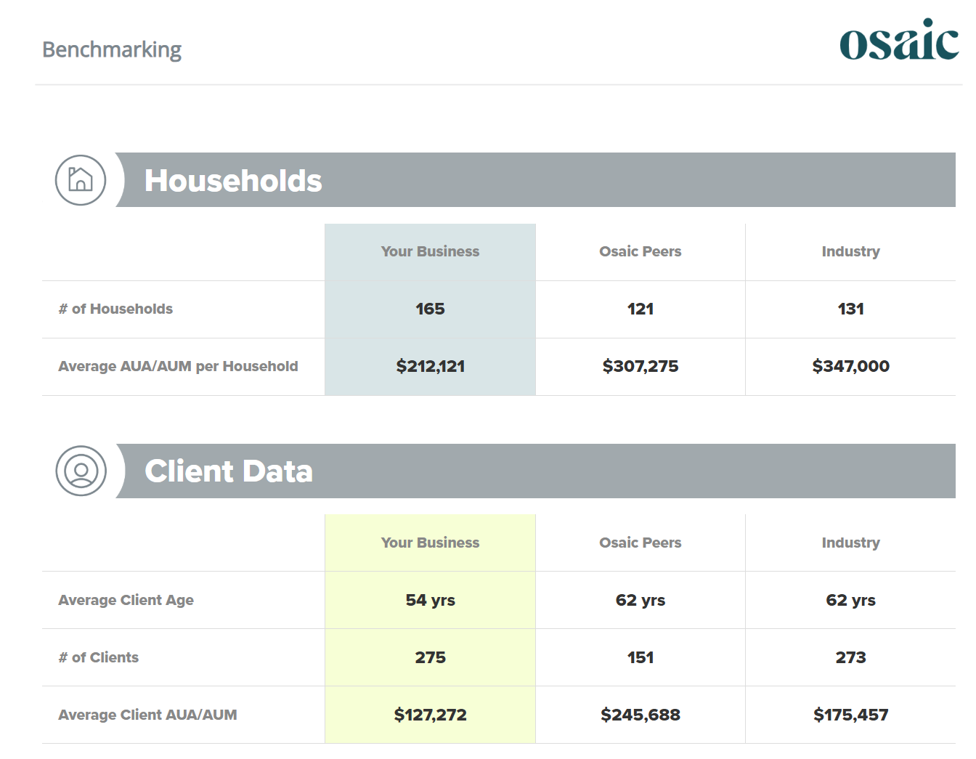
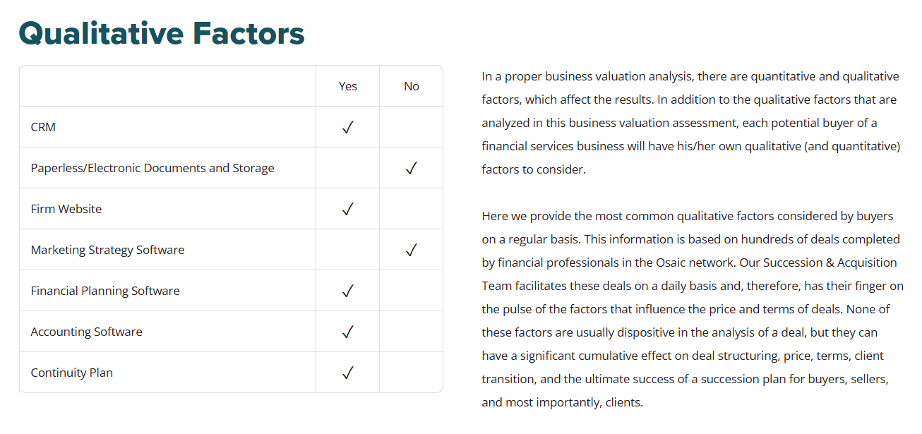
Business Valuation Estimate
Receive a market-based Business Valuation Estimate at no cost! Take as many times as you would like.

Slide 8
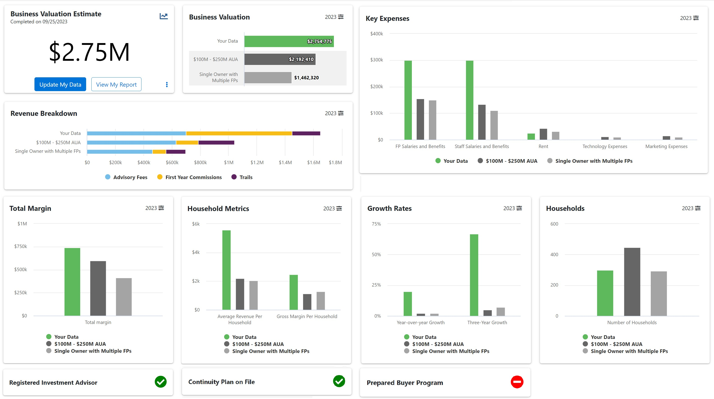
Valuation Insights
When you complete your Business Valuation Estimate you will receive access to the Valuation Insights dashboard where you can compare yourselves to peer benchmarks.

Slide 9
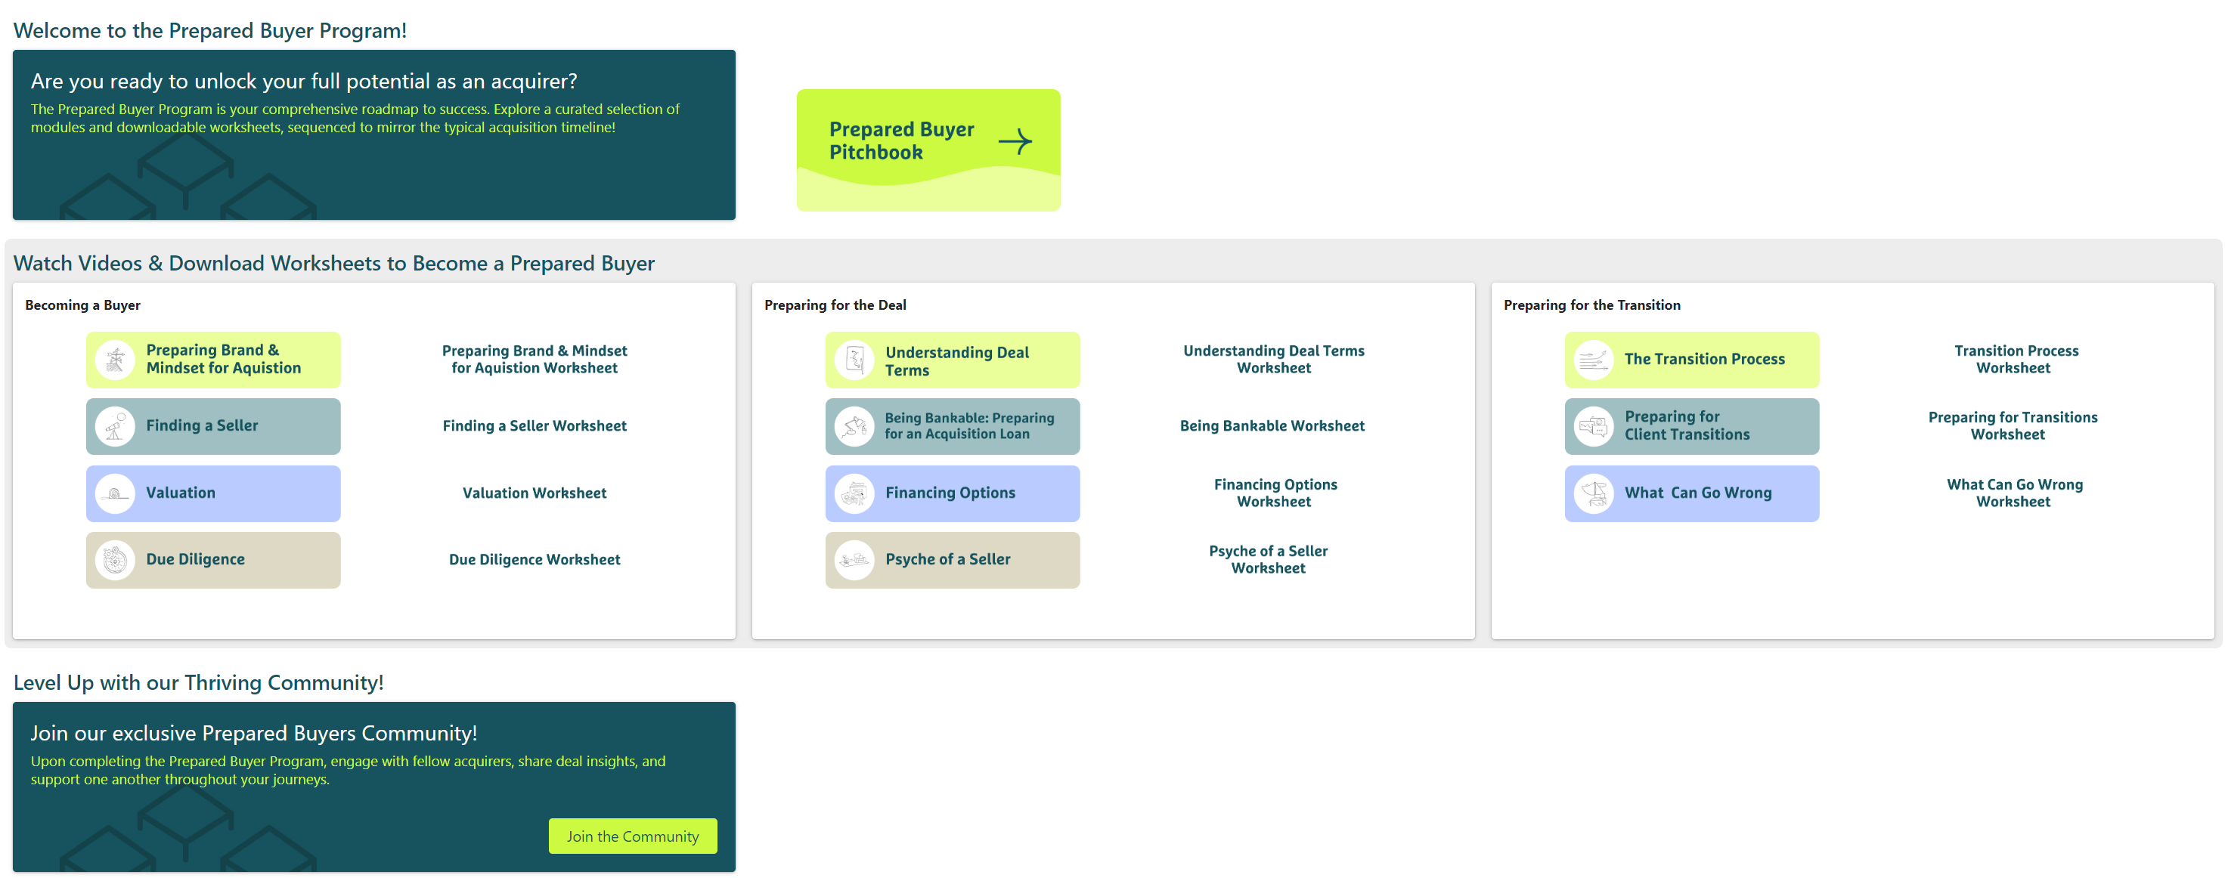
Prepared Buyer Program
Interested in acquiring another practice? Osaic’s Succession and Coaching Teams have packaged a self-service dashboard for you to use at no cost!
ENGAGEMENT & ORGANIC GROWTH CORE STAKEHOLDERS

Slide 10
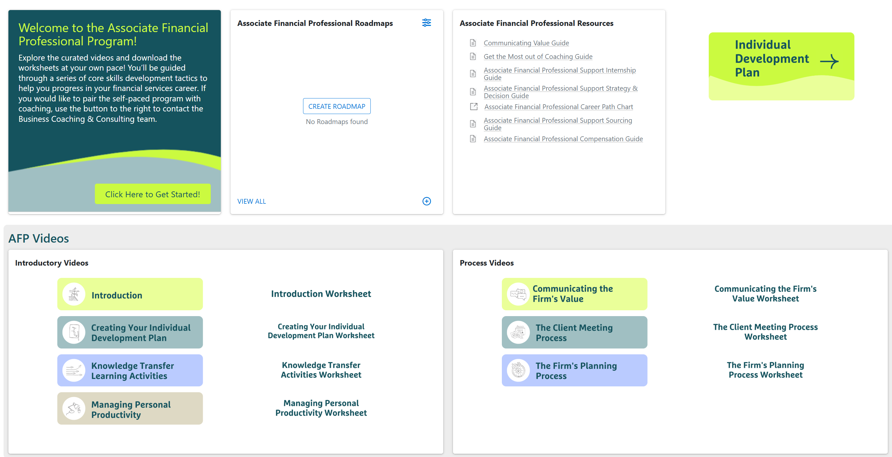
Associate Financial Professional
Osaic’s Coaching and NextGen Team has created this self-service dashboard at no cost as part of its commitment to helping you grow your business!

Slide 11
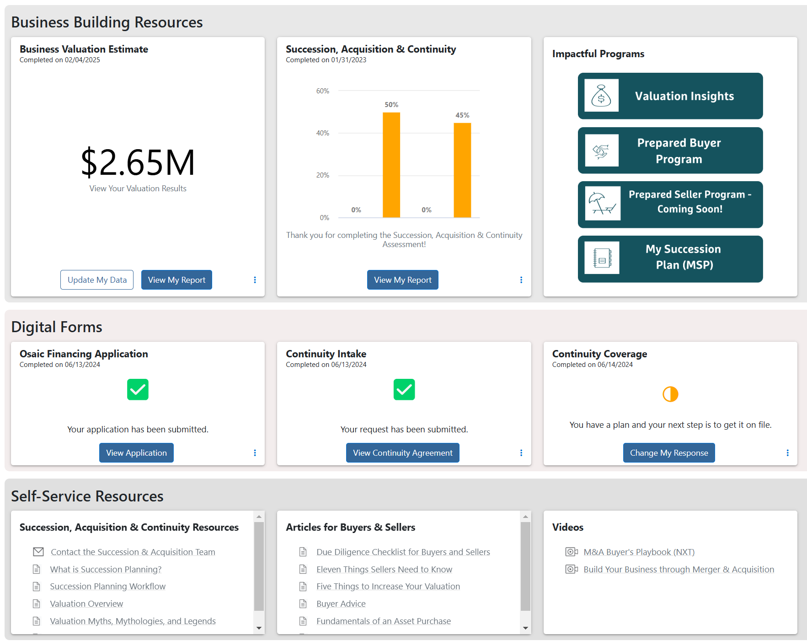
Succession, Continuity, Financing & Acquisition Resources
Everything you need is available on one dashboard!
Continuity Agreement now has e-Signature Enabled via DocuSign

Slide 12
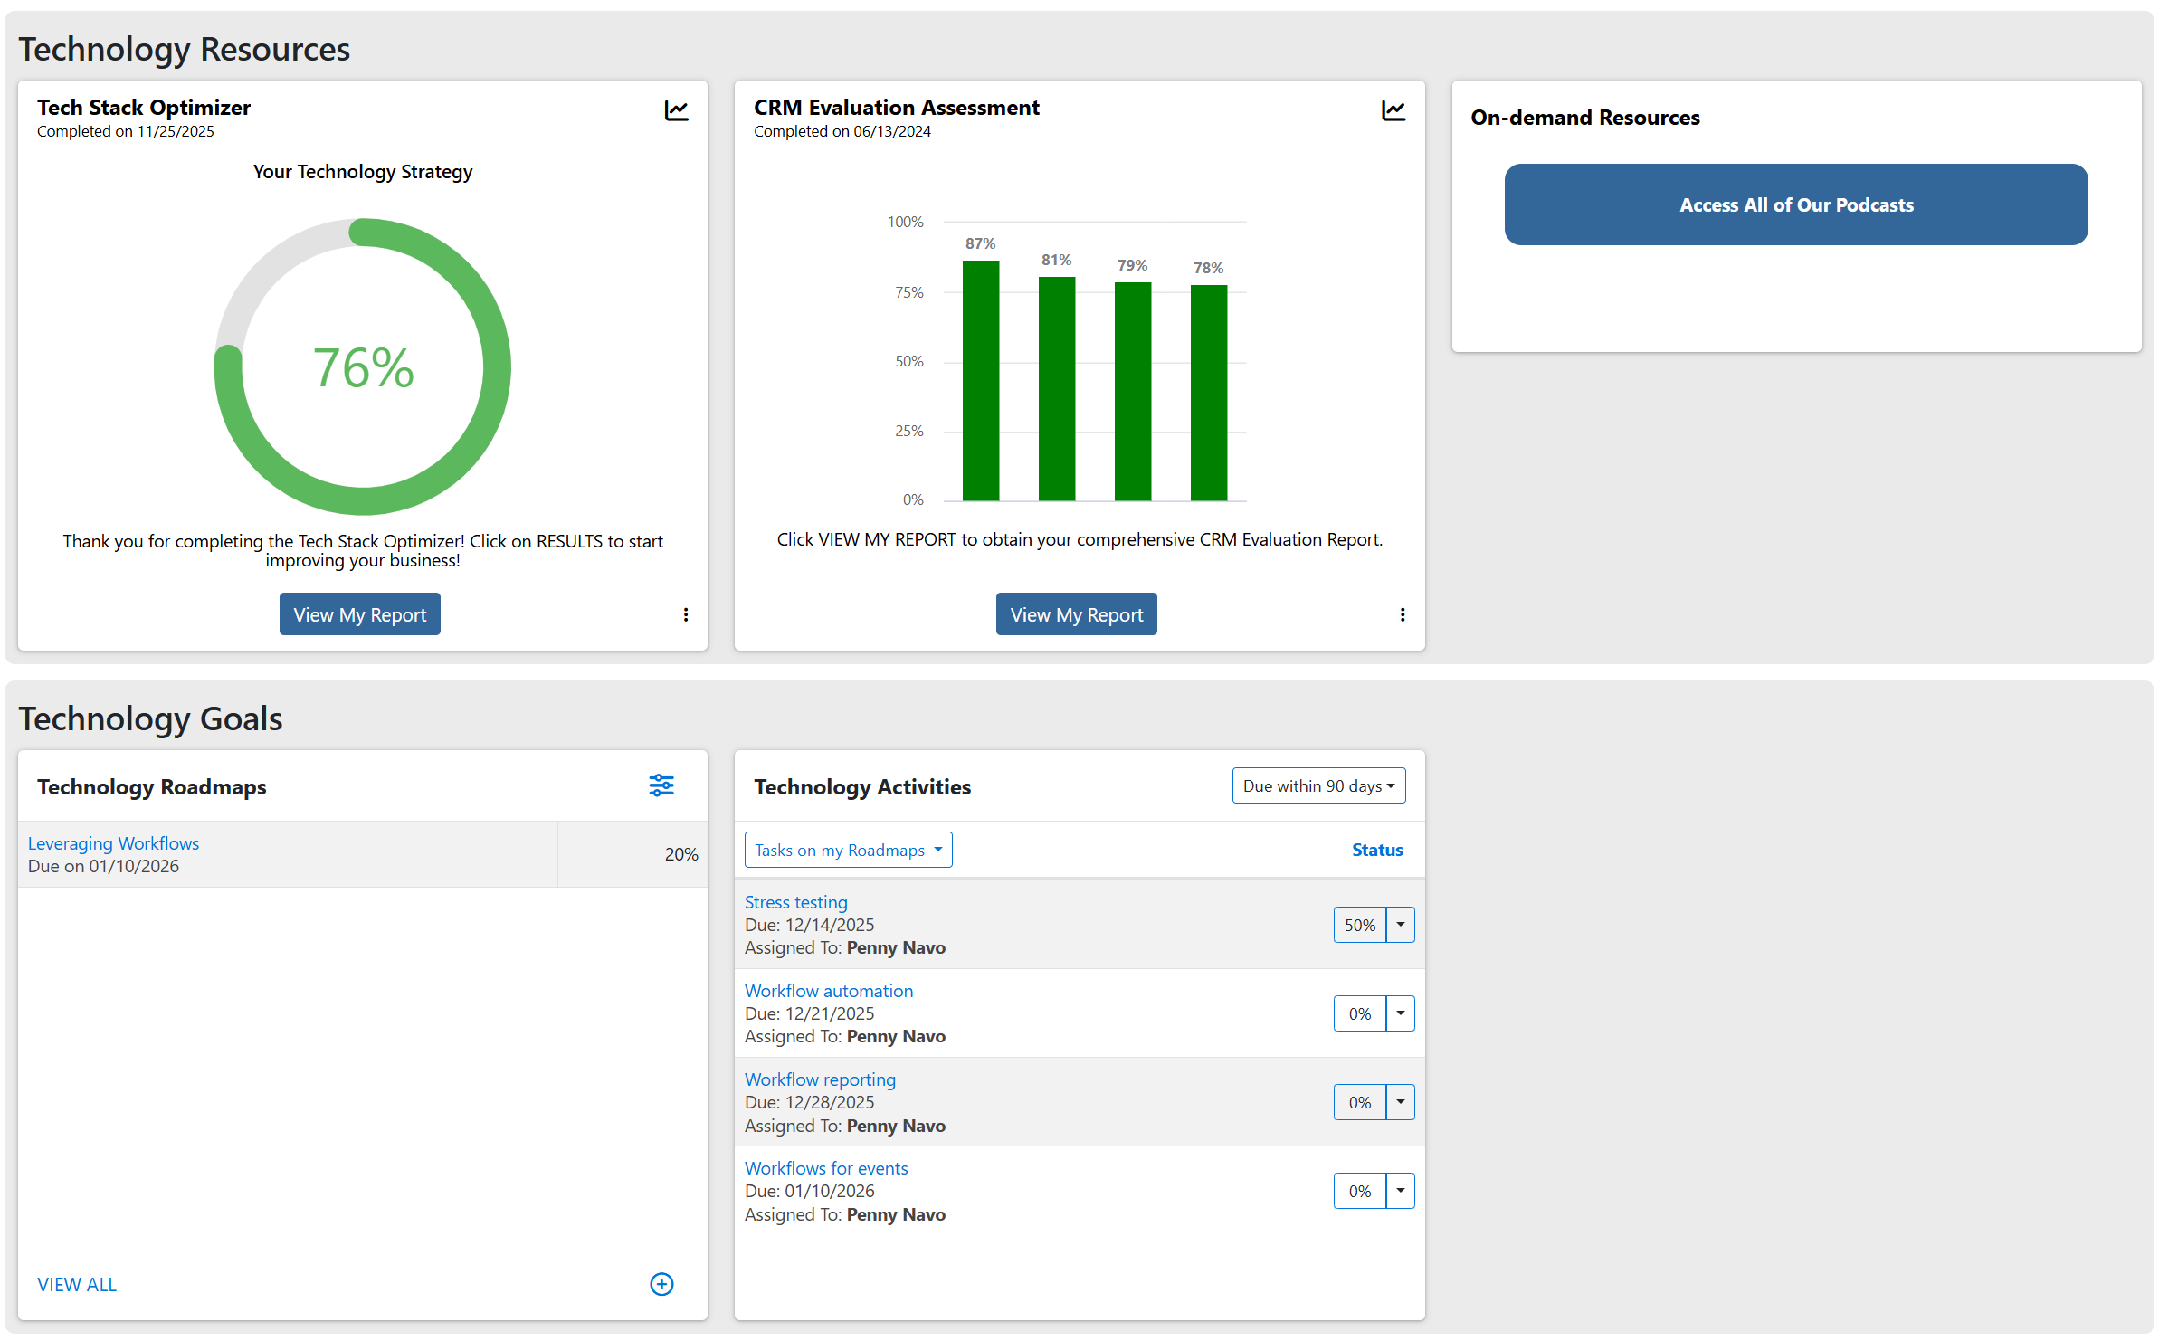
Technology Solutions
We are in the process of creating an AI Readiness Assessment

Slide 13
Enhanced Access
Engagement Model with the Advisors in Your Enterprise

Slide 14
Your Set-up
We created a partition for your Enterprise so you can isolate reporting and access.
Just let us know who else in your Enterprise should be able to work with your Advisors and we will adjust their access. This enhanced access provides a lot of transparency, but also is a more complicated user experience.
  If you are not the Enterprise Leader, your experience will be slightly different.
You will want to access My Business Builder directly from the login screen going forward (next slide).
You or your designee will be provided with the ability to “launch and work with” advisors in your Enterprise.
You or your designee will be able to receive a weekly activity digest of all completed activity in your Enterprise or follow activity within your Enterprise.
Your Relationship Leader will work with you on preparing an impactful presentation for meetings with your group.

Slide 15
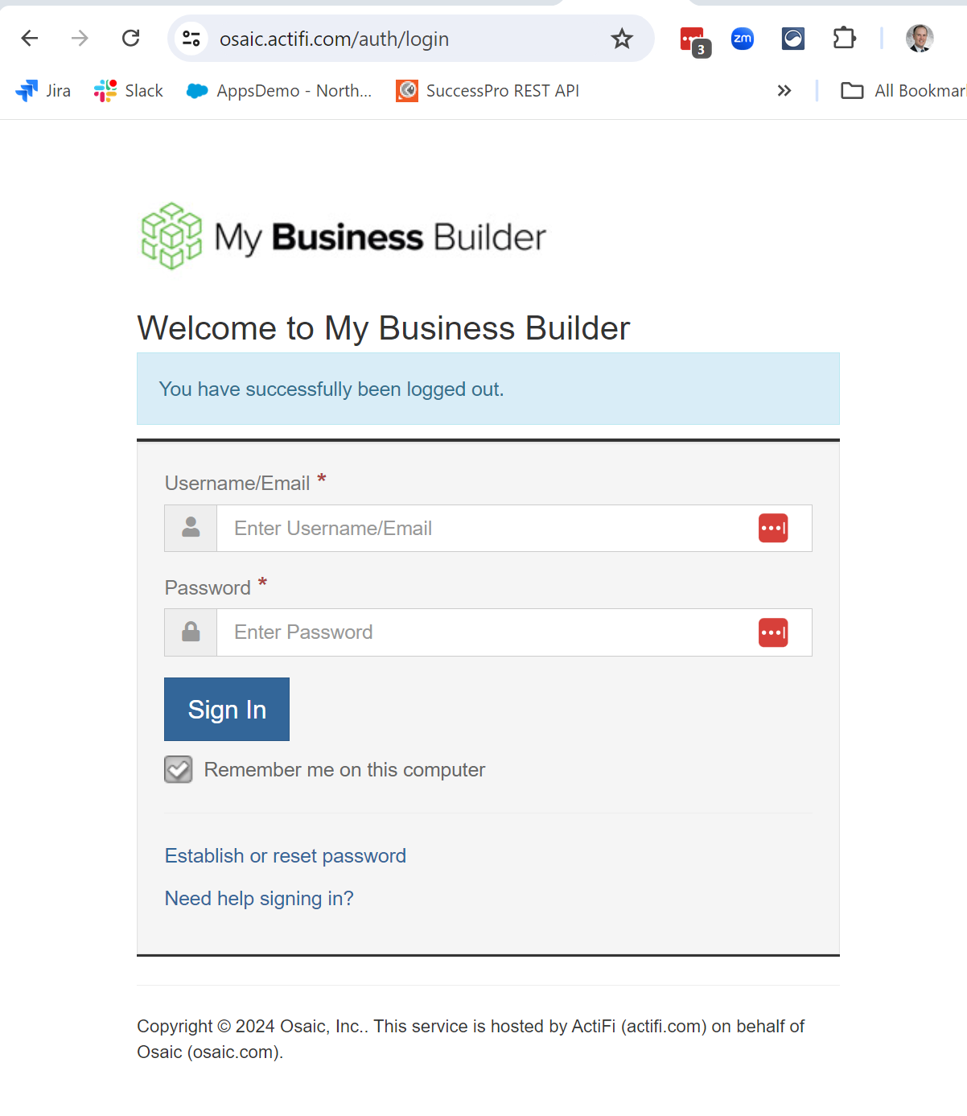
Direct Login Instructions for You
Open your Google Chrome browser
Navigate to this URL (and save to favorites): osaic.actifi.com
Enter your Username as your email address and click “Remember me on this computer” for future sessions
  First time? Click Establish or Reset Password
  Forgot your password? Click Establish or Reset Password
  Unable to sign-in? Contact mybusinessbuilder@osaic.com or support@actifi.com

Slide 16
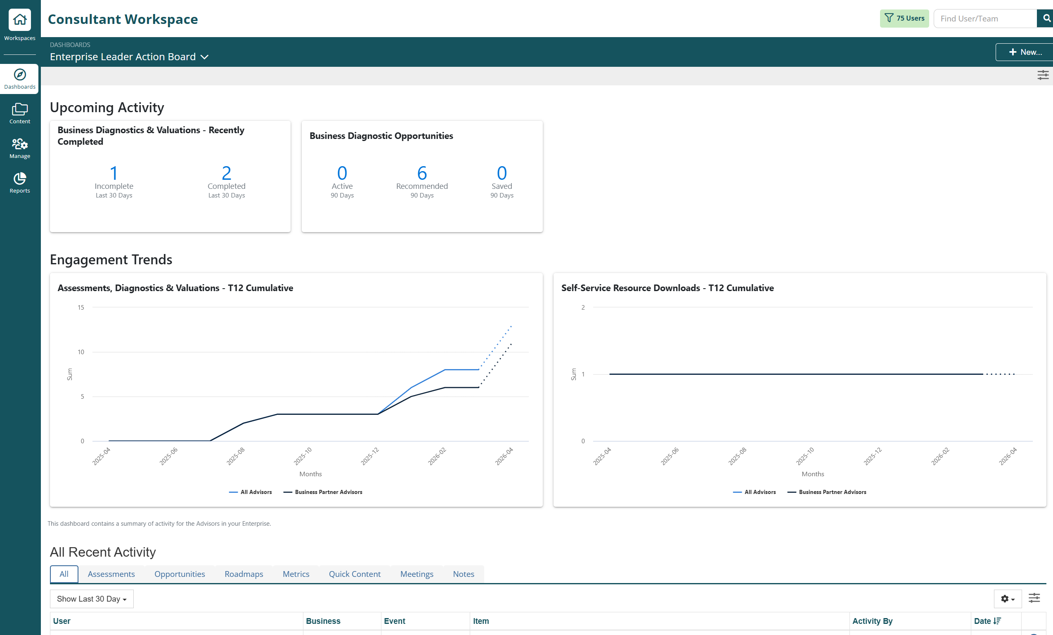
What You Will See After You Log In with Enhanced Access
5
1
Search for a specific Financial Professional within your Enterprise
View Upcoming & Recent Activity for the FPs you have access to see.
Click on the name of the Advisor in this list and you will navigate to their record.
View data across the FPs you have access to see (Content, Users/Teams you Manage, Reports)
Click on workspace and select either “my workspace” or your name to go right to your record – feel free to play around and test things out!
Click on the “Content” icon to view specific activity across your Advisors (e.g., all Business Valuation Estimates)
6
4
2
3

Slide 17
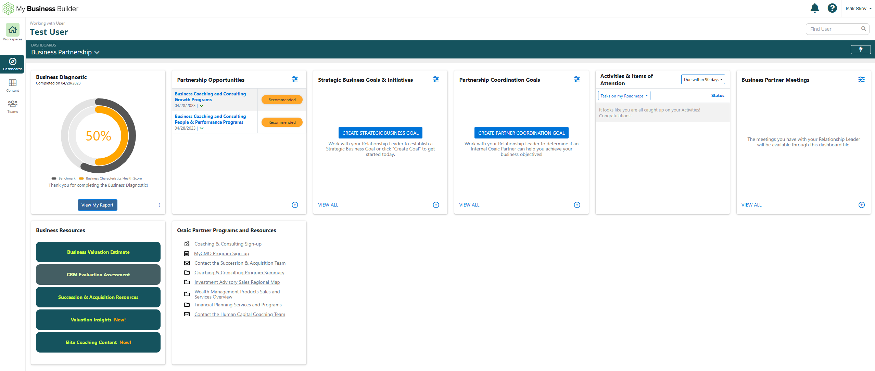
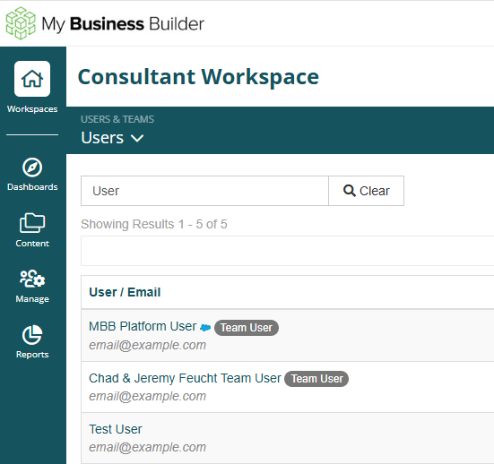
Working with an Advisor – All you need to do is click on their name
Wherever you see the name of one of your Advisors (ex: Search) you can just click and you will be taken to their dashboard. You have been given the access to work with their record and the system will record your activities versus their activities.

Slide 18
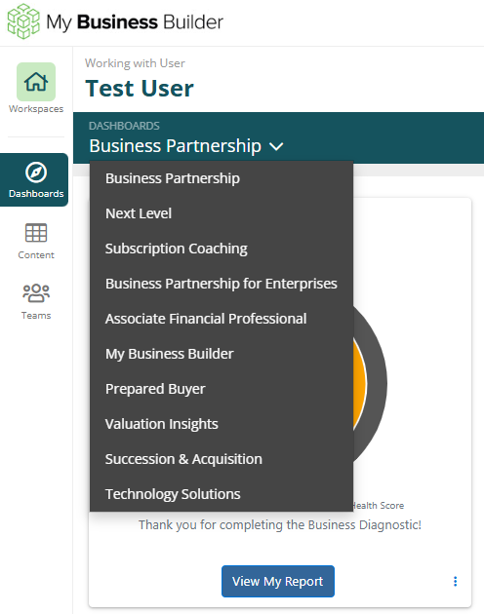
Navigating Your Financial Professional’s Workspace
1
You can tab across their visual Dashboards which are a curation of engagement solutions from the Teams at Osaic (these may vary from advisor-to-advisor)
You can tab across detailed data grids of all activity for the Advisors you manage.
2

Slide 19
Other Access and Notification Options
Advisor Access
Advisors within your enterprise could ALSO access the MBB System one of three ways:
  Through direct login (like you)
  Through an expanded embedded link to tools such as the Business Valuation and other Dashboards
  Through a “link” to an Assessment you can send to your Financial Professionals
Additional Content
Advisors within your enterprise have access to the Associate Financial Professional Toolkit, MBB Assessments, Valuation Tool, Valuation Insights, Advisor Technology Toolkit and Succession & Acquisition Resources.
Some may also have a tab called “Business Partnership” that would allow for you to establish and track business goals with them.
Following Assessments
You can “follow” Assessments to receive emails every two hours summarizing activity across your Enterprise.
Weekly Activity Digests
We can set-up a weekly digest that will give you a summary of Activity across your Enterprise so you can get a pulse check of what is occurring.

Slide 20
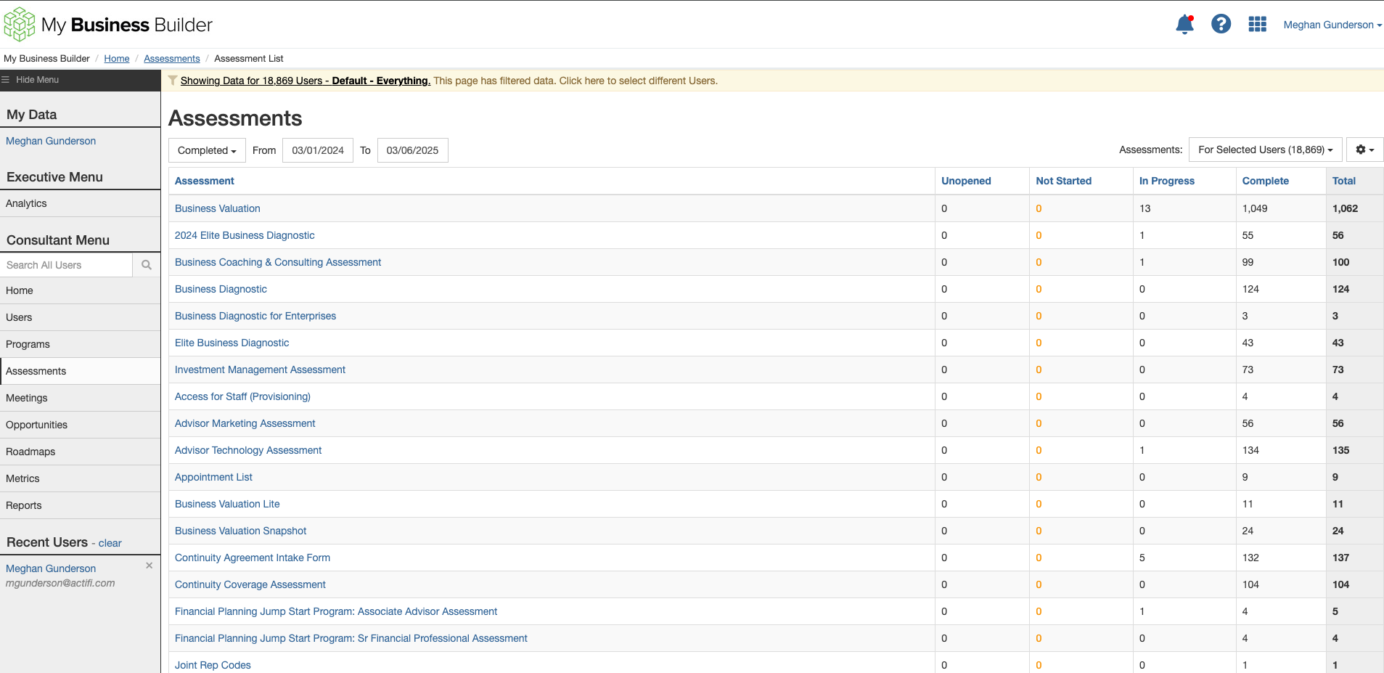
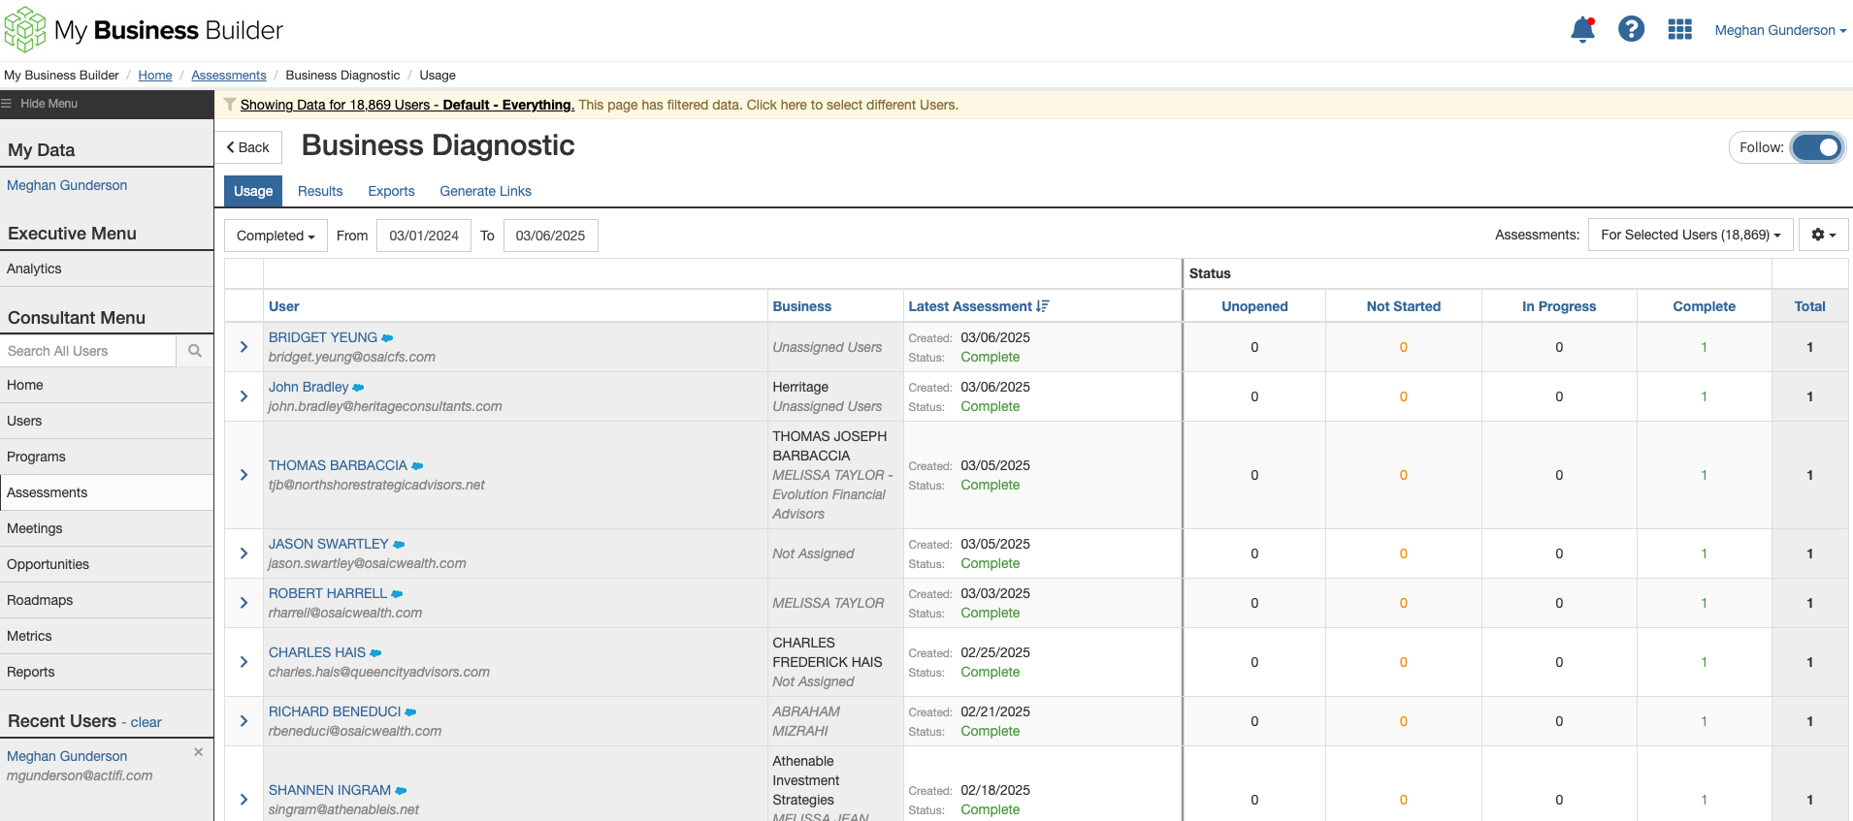
How to Follow an Assessment
Select “Assessments” from the left menu
Click the name of the assessment you wish to follow
Select the “Follow” button in the upper right corner
Make sure you have your Notifications configured to receive emails and alerts (see next slide)
2
1
3

Slide 21
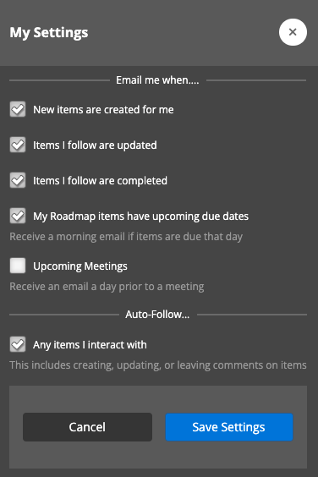
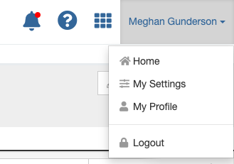
Configure Notifications
1
Select your name from the upper right corner
Click “My Settings” from the dropdown menu
Check the boxes next to the desired items to receive Notification emails (be sure to select the “Items I follow are updated” and “Items I follow are completed” boxes)
Select the “Save Settings” button
2
3
Please Note: Email notifications are sent every two hours on the hour according to Central Standard Time (i.e. 10:00 AM, noon, 2:00 PM). Each email contains a summary of all updates that occurred during the two-hour timespan. An email notification will not be sent if there are no updates or new items created during that time.
4

Slide 22
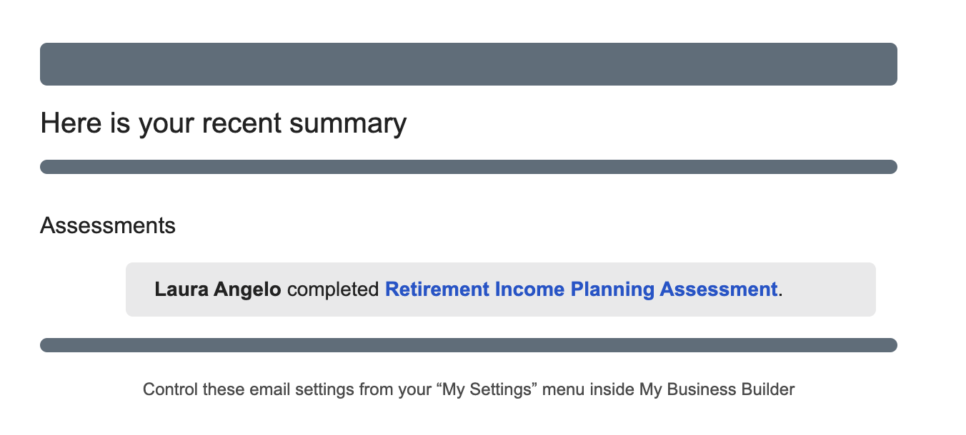
Sample Notification Email for a Completed Assessment

Slide 23
Questions?
Contact your Relationship Leader or ActiFi at support@actifi.com

