Slide 1

Reinvent Your Retirement Assets:
Forg0tten assets that solve a need you never knew existed
David Shoup, Chief Business Development Officer
Cam Bando, Case Design and Business Development

Slide 2

The Problem
Clients years ago were sold annuities with the promise of providing supplemental income in their retirement years…
What they didn’t realize is the tax burden that awaits…
Annuities provide steady, tax-deferred growth, but annuitization can lead to unwanted tax consequences in retirement.
Why not maximize that growth with a tax efficient solution to a problem that most don’t realize until it’s too late
When is the last time you discussed Long Term Care?
-

Slide 3
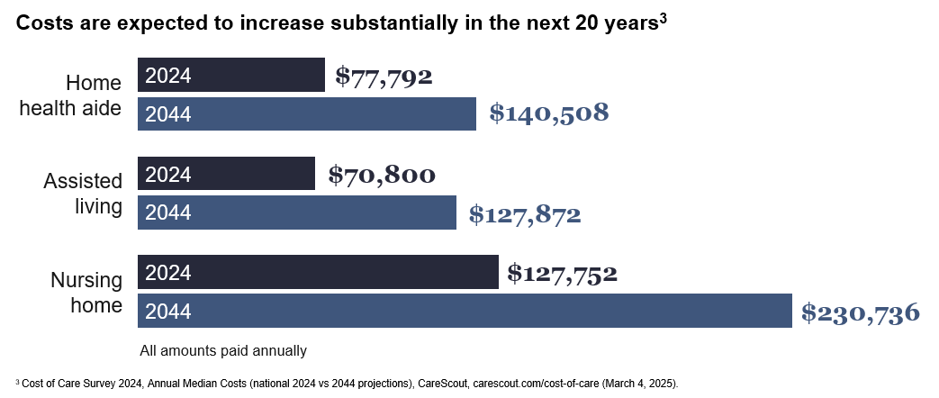
Rising Cost of Care
Notes:
Avg rent nationwide back in 2000 was $600. Today its more than doubled. The cost of long term care is no different, and likely will continue to rise in the next 20 years.

Slide 4
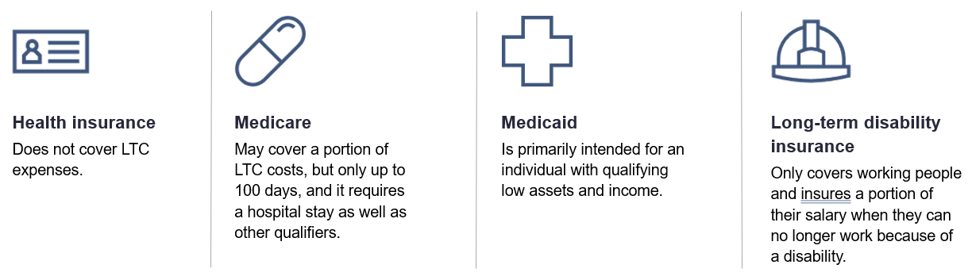

LTC Misconceptions
Notes:
Long-term care costs can quickly add up.
A common misconception is that health insurance and Medicare or Medicaid will cover these expenses, but that’s often not the case.
Many people also mistake long-term disability insurance with long-term care coverage. Disability insurance is design to help replace lost wages as a result of a disability. Typically, this kind of coverage is associated with employment and often terminates when you retire. It’s also typically not offered to older people.
The truth is that clients will need to cover many of these costs themselves in the form of either cash or private insurance.
Generally, none of these types of coverage will pay for:
Assisted living facilities
The many costs of home health care
Adult day care services

Slide 5
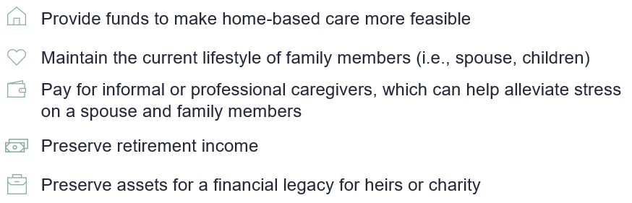
Planning for Long Term Care
What LTC coverage can provide
Provide funds to make long term case expenses more feasible
Maintain the current lifestyle of family members (i.e. spouse, children)
Pay for informal or professional caregivers, which can help alleviate stress on a spouse and family members
Preserve retirement income
Preserve assets for a financial legacy for heirs of charity
Notes:
A plan to cover long-term care costs can help your clients in a variety of ways. It can help make home-based care more feasible. But it can also help protect the family’s lifestyle and financial security or even help maintain a financial legacy for the client’s heirs. There are numerous products that can be used to accomplish this, so next, we’re going to talk about some common solutions for long-term care coverage.

Slide 6
The Solution
A tax-optimized solution,
Fixed Annuity with Long-Term Care Benefit
Allows a tax-free exchange from an existing nonqualified annuity or life policy to fund the contract
Tax-deferred growth of the contract value
Tax-free Long Term Care benefits*
Benefits are tax free up to the greater of the HIPAA daily limit in the year of claim or the actual qualifying long-term care cost incurred. Benefits may be taxable under certain circumstances. Clients should consult their tax advisor.

Slide 7
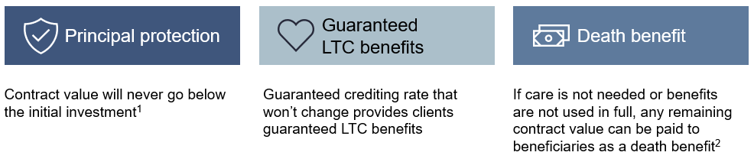
Key Product Features
Long-term care coverage with guaranteed benefits

Slide 8
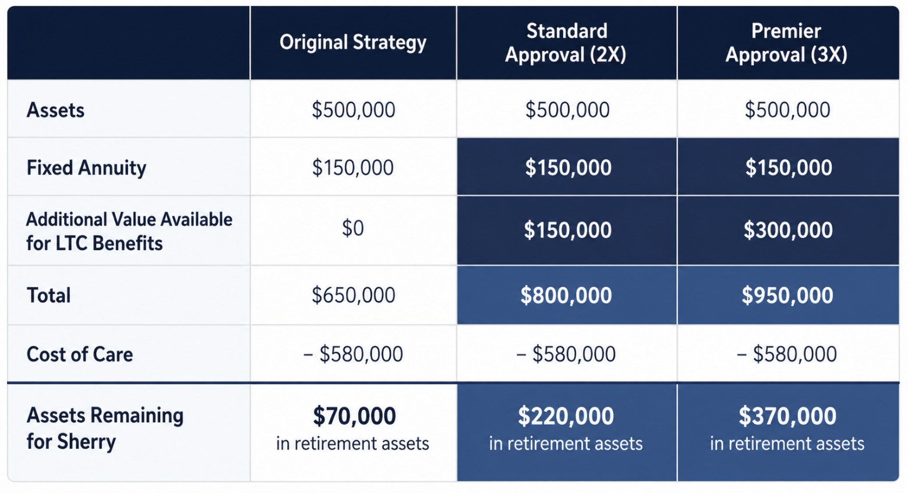
Case Study
Rick and Sherry Smith
68 & 62 Years old
500k in 401(k), Stock, Bonds, and Savings
150k fixed annuity
No Debt
Believe they can self insure
Notes:
Example shows if Rick goes on claim in 5 years into retirement.

Slide 9


